Slide 1
SPI Protocol
Implementation on FPGA

Slide 2
Overview of SPI
SPI ➔ Serial Peripheral Interface
Synchronous, Serial, Suitable for short distance, Master/Slave protocol
The four main input/output lines are
CS/SS → Chip Select/Slave Select
MISO → Master In Slave Out
MOSI → Master Out Slave In
SCLK → SPI Clock
when CS/SS change from 1 to 0, indicates transmission to begin
spi_clk is derived from clk, spi_clk is slower than clk and transmission occur at the rate of spi_clk
The data output from Master will go on line MOSI which is internally fetched from data_wr signal.
The data input to Master will come through MISO and written onto data_rd line internally.
Depending on Phase and Polarity, the SPI data can be transmitted in 4 different format as depicted in table below
Polarity | Phase | SPICLK IDLE State | MOSI (Data Output) | MISO (Data Input)
0 | 0 | 0 | Falling | Falling
0 | 1 | 0 | Rising | Rising
1 | 0 | 0 | Falling | Falling
1 | 1 | 0 | Rising | Rising

Slide 3
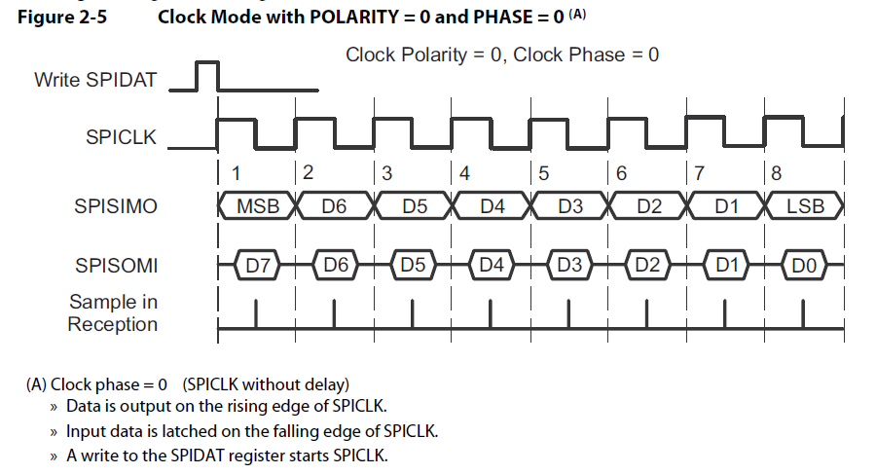
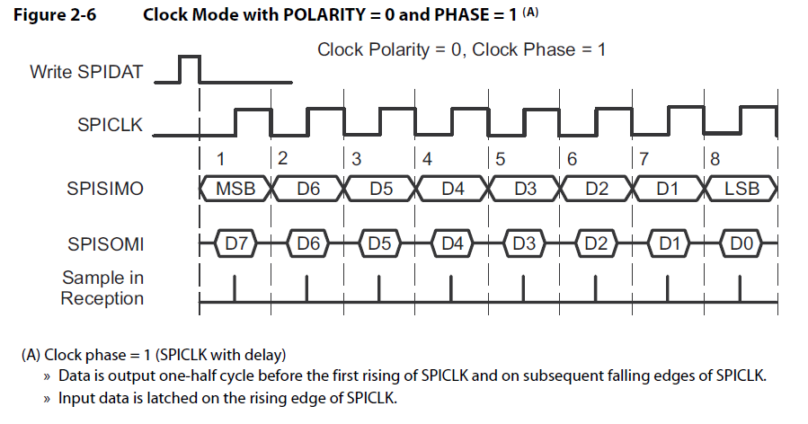
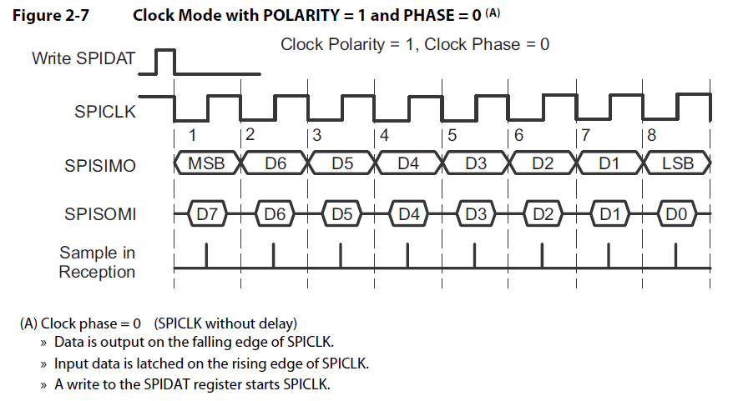
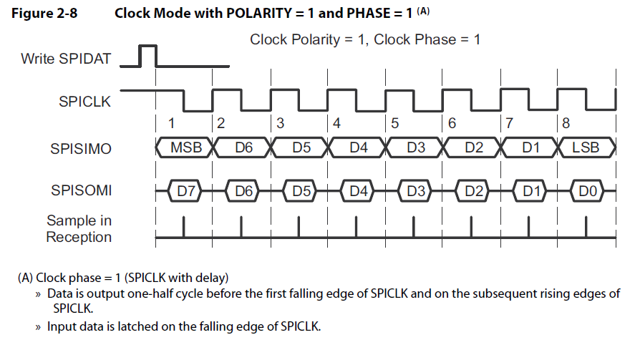
Polarity | Phase | Action | MOSI (Data Output) | MISO (Input Data)
0 | 0 | Data is output on +ve edge of SPICLK Input data is latched on falling edge of SPICLK | +ve edge | +ve edge
0 | 1 | Data is output one half cycle before the first +ve edge of SPICLK and on subsequent falling edges Input data is latched on rising edge of SPICLK | 1st output – one and half cycle before 1st +ve edge Remaining on –ve edge | 1st output – one and half cycle before 1st +ve edge Remaining on –ve edge
1 | 0 | Data is output on -ve edge of SPICLK Input data is latched on rising edge of SPICLK | -ve edge | -ve edge
1 | 1 | Data is output one half cycle before the first -ve edge of SPICLK and on subsequent rising edges Input data is latched on falling edge of SPICLK | 1st output – one and half cycle before 1st +ve edge | 1st output – one and half cycle before 1st +ve edge

Slide 4
Final Waveform Result

Slide 5
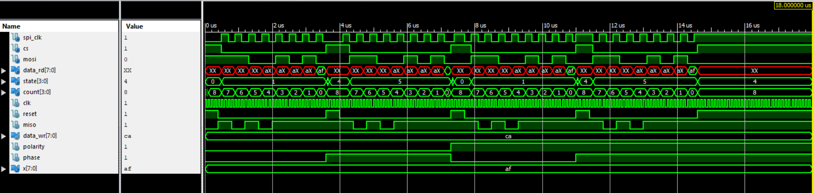
Output from Master
MOSI/data_wr ➔ 11001010 ➔ CAh
Output from Slave
MISO/data_rd ➔ 10101111 ➔ AFh
Polarity = 1, Phase =1
SPI idle clock = 1 @ reset = 1
Data transition at -ve edge
Polarity = 1, Phase =0
SPI idle clock = 1 @ reset = 1
Data transition at +ve edge
Polarity = 0, Phase =1
SPI idle clock = 0 @ reset = 1
Data transition at -ve edge
Polarity = 0, Phase =0
SPI idle clock = 0 @ reset = 1
Data transition at +ve edge
1
1
0
0
1
0
1
0
0
1
1
0
0
1
0
1
0
0
1
1
0
0
1
0
1
0
0
1
1
0
0
1
0
1
0
0
Data = MOSI = 11001010
Data = MOSI = 11001010
Data = MOSI = 11001010
Data = MOSI = 11001010

Slide 6
References
https://www.ti.com/lit/ug/sprugp2a/sprugp2a.pdf
http://ww1.microchip.com/downloads/en/devicedoc/spi.pdf
https://www.nxp.com/docs/en/application-note/AN3904.pdf
https://www.analog.com/en/analog-dialogue/articles/introduction-to-spi-interface.html
https://dlnware.com/dll/Clock-Phase-and-Polarity

